Slide 1
Financial Management

Slide 2
Definition of Financial Management
–
Managerial activities which deals with planning and controlling of firms and financial sources.
–
Financial management is an area of financial decision making, harmonsing individual motives and enterprise goals.
- Weston Brigham

Slide 3
Scope of financial management
The scope and functions of financial management is classified in two categories.
Traditional approach
Modern approach

Slide 4
Traditional approach
●
According to this approach, the scope of the finance function is restricted to “procurement of funds by corporate enterprise to meet their financial needs.
●
The term ‘procurement’ refers to raising of funds externally as well as the inter related aspects of raising funds.

Slide 5
Traditional approach
The inter related aspects are the institutional arrangement for finance, financial instruments through which funds are raised and legal and accounting aspects between the firm and its sources of funds.
●
In traditional approach the resources could be raised from the combination of the available sources.

Slide 6
Limitations of traditional approach
This approach is confirmed to ‘procurement of funds’ only.
It fails to consider an important aspects i.e. allocation of funds.
It deals with only outside I.e. investors, investment bankers.

Slide 7
Limitations of traditional approach
The internal decision making is completely ignored in this approach.
The traditional approach fails to consider the problems involved in working capital management.
The traditional approach neglected the issues relating to the allocation and management of funds and failed to make financial decisions.

Slide 8
Modern approach
The modern approach is an analytical way of looking into financial problems of the firm.
According to this approach, the finance function covers both acquisition of funds as well as the allocation of funds to various uses.
Financial management is concerned with the issues involved in raising of funds and efficient and wise allocation of funds.

Slide 9
Main Contents of Modern approach
How large should an enterprise be and how far it should grow?
In what form should it hold its assets?
How should the funds required be raised?
- Financial management is concerned with finding answer to the above problems.

Slide 10
Functions of Finance
There are three finance functions
Investment decision
Financing decision
Dividend decision

Slide 11
Investment Decision
Investment decision relates to selections of asset in which funds will be invested by a firm.
The asset that can be acquired by a firm may be long term asset and short term asset.

Slide 12
Investment Decision
Decision with regard to long term assets is called capital budgeting.
Decision with regard to short term or current assets is called working capital management.

Slide 13
Capital Budgeting
Capital budgeting relates to selection of an asset or investment proposal which would yield benefit in future. It involves three elements.
The measurement of the worth of the proposal

Slide 14
Capital Budgeting
Evaluation of the investment proposal in terms of risk associated with it and
Evaluation of the worth of the investment proposal against certain norms or standard. The standard is broadly known as cost of capital

Slide 15
Financing Decision
Determination of the proportion of equity and dept is the main issue in financing decision.
Once the best combination of debt and equity is determined, the next step is raising appropriate amount through available sources.

Slide 16
Working Capital Management
Working capital management or current asset management is an important part of investment decision.
Proper management of working capital ensures firm’s liquidity and solvency.
A conflict exists between profitability and liquidity while managing current asset.

Slide 17
Working Capital Management
If a firm does not invest sufficient funds in current assets it may become illiquid and may not meet its current obligations.
If the current asset are large, the firm would lose its profitability and liquidity.
The financial manager should develop proper techniques of managing current assets so that neither insufficient nor unnecessary funds are invested in current assets.

Slide 18
Management of Working Capital
The management of working capital has two aspects.
Overview of working capital management and
Efficient management of individual current asset such as cash, receivable and inventory.

Slide 19
Financing Decision
Financing decision is concerned with the financing mix or capital structure.
The mix of debt and equity is known as capital structure.

Slide 20
Dividend Decision
A firm distribute all profits or retain them or distribute a portion and retain the balance with it.
Which course should be allowed? The decision depends upon the preference of the shareholders and investment opportunities available to the firm.

Slide 21
Dividend Decision
Dividend decision has a strong influence on the market prize of the share.
So the dividend policy is to be determined in terms of its impact on shareholder’s value.
The optimum dividend policy is one which maximizes the value of shares and wealth of the shareholders.

Slide 22
Dividend Decision
The financial manager should determine the optimum pay out ratio I.e. the proportions of net profit to be paid out to the shareholders.
The above three decisions are inter related. To have an optimum financial decision the three should be taken jointly.

Slide 23
Objectives of financial management
The term ‘objective’ refers to a goal or decision for taking financial decisions.
Profit maximisation
Wealth maximisation

Slide 24
Profit maximisation
The term profit maximisation is deep rooted in the economic theory.
It is need that when firms pursue the policy of maximising profits.
Society’s resources are efficiently utilised.

Slide 25
Profit maximisation
The firm should undertake those actions that would profits and drop those actions that would decrease profit.
The financial decisions should be oriented to the maximisation of profits.
Profit provides the yardstick for measuring performance of firms.

Slide 26
Profit maximisation
It makes allocation of resources to profitable and desirable areas.
It also ensures maximum social welfare.

Slide 27
Wealth maximisation
Wealth maximisation or net present value maximisation provides an appropriate and operationally feasible decision criterion for financial management decisions.

Slide 28
Sources of Finance
Capital required for a business can be classified under two main categories, viz.,
Fixed Capital, and
Working Capital.
every business needs funds for two purposes.
for its establishment and to carry out its day-to- day operations.

Slide 29
Sources of Finance
Long term funds are required to create production facilities through purchase of fixed assets such as
plant,
machinery,
land,
building,
furniture, etc.

Slide 30
Sources of Finance
- Investment in these asset represent that part of firm’s capital which is blocked on permanent or fixed basis and is called fixed capital.
Funds are also needed for short-term purposes for the purchase of raw materials, payment of wages and other day to day expenses, etc. These funds are known as working capital.

Slide 31
Sources of Finance/Funds
●
In our present day economy, finance is defined as the provision of money at the time when it is required.
●
Every enterprise, whether big or medium or small, needs finance to carry on its operations and to achieve its targets.

Slide 32
Sources of Finance/Funds
●
In fact finance is so indispensable today that is rightly said that it is the life blood of enterprise.
●
With out adequate finance, no enterprise can possibly accomplish its objectives.
●
In every concern there are two methods of raising finance, viz.,
-
-
Raising of owned capital, Rising of borrowed capital

Slide 33
Sources of Finance/Funds
●
The financial requirements may be for a long term, medium term or short term.
Financial Requirements
Short-Term
Bank Credit Customer advances Trade Credit
Medium-Term
Issue of Debentures
Issue of Preference shares Bank Loan
Public deposit / Fixed deposit
Long-Term
Issue of shares Issue of Debentures
Ploughing back of profits
Loan from Loans from financial institutions _{spec.financial}
institutions

Slide 34
Issue of shares
The company’s owned capital is split into large number of equal parts,such a part being called a “share”.
The person holding the share as shareholder and becomes part-owner of the company.
For this reason, the capital so raised is known as “owned capital” and the shares are called “ownership securities”.

Slide 35
Issue of shares
The share capital of the company is ideal for meeting the long term requirements.
It need not be paid back to the shareholders within the life time of the company.
The only exception is the sum raised by the issue of redeemable preference shares.

Slide 36
Types of shares
A public company can issue two types of share.
Equity share
Preference share

Slide 37
Equity share
Equity share has number of special features
The dividend on these shares are paid after the dividend on preference share has been paid.
The rate of dividend depends upon the amount of profits available and the intention of directors.

Slide 38
Equity share
The Equity shareholders have the chance of earning good dividends in times of prosperity and run the risk of earning nothing in times of adversity.
The equity shareholders have a residual claim on the company’s asset in case of liquidation.
The company is controlled by the equity shareholders and they are entitled to vote in the meetings of the company.

Slide 39
Preference shares
Preference shares are those which carry preferential right over other class of shares with regard to payment of dividend and repayment of capital.
The rate of dividend on preference share is a fixed one.

Slide 40

Stocks and Break even

Slide 41
‘ Why Do we Invest?
1. Purpose of Investment
Investing is essential to combat inflation and ensure financial preparedness for the future.
2. Historical Background Stock
Markets have a rich history dating back to the 1800s when brokers conducted trades under Banyan trees. In 1854, they relocated to Dalal Street, where the Bombay Stock Exchange (BSE), Asia's oldest stock exchange, is located.
3. Evolution of Stock Exchanges
The BSE played a pivotal role in India's financial landscape. In 1993, the National Stock Exchange (NSE) was formed, marking a significant development in India's stock market infrastructure. Both exchanges transitioned from open outcry systems to automated trading environments, enhancing efficiency.

Slide 42
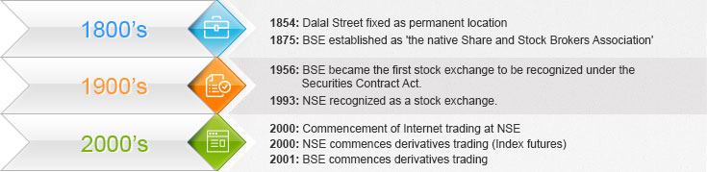
Why Do we Invest?
4. Significance of BSE Sensex The BSE Sensex serves as a key indicator of India's economic and financial health, reflecting the performance of major stocks listed on the BSE.
5. Investment Perception Despite its historical significance, investing in the stock market can seem daunting. However, understanding investment fundamentals can demystify the process and empower investors to navigate the market confidently.

Slide 43
What is Stock Market?
Definition A share market is a marketplace where shares of publicly-traded companies are issued and traded.
Comparison with Stock Market While share market specifically deals with the trading of shares, a stock market encompasses a broader range of financial instruments such as bonds, mutual funds, and derivatives in addition to shares.
Role of Stock Exchanges Stock exchanges serve as the fundamental platforms facilitating the trading of company stocks and other securities. Companies must be listed on an exchange for their stocks to be bought or sold.
Prominent Stock Exchanges in India India's major stock exchanges include the Bombay Stock Exchange (BSE) and the National Stock Exchange (NSE), which serve as key meeting places for buyers and sellers of stocks.

Slide 44

Types of Share Market

Slide 45
Types of Share Market
Primary Market
Definition The primary market is where companies issue new shares to raise capital by getting listed on a stock exchange.
Initial Public Offering (IPO) When a company sells shares to the public for the first time, it's termed as an IPO, marking its transition to a publicly traded entity.
Purpose Companies enter the primary market to raise funds for various purposes such as expansion, research and development, debt repayment, or general corporate purposes.
Becoming Public Through the primary market, a company becomes publicly owned, allowing investors to participate in its ownership by purchasing shares.

Slide 46
Types of Share Market
Secondary Market
Definition The secondary market is where already issued securities, including shares, are traded among investors.
Purpose It provides liquidity to investors by offering them the opportunity to buy and sell shares after the initial issuance.
Transactions Secondary market transactions involve investors buying shares from or selling shares to other investors, rather than directly from the issuing company.
Intermediaries Investors typically use intermediaries like brokers to facilitate transactions in the secondary market, ensuring smooth and regulated trading.

Slide 47
How To Buy Shares?
First, you need to open a trading account and a demat account. This trading and demat account will be linked to your savings account to facilitate smooth transfer of money and shares.
We offer various trading tools to buy and sell shares that caters to our diversified set of traders and investors

Slide 48
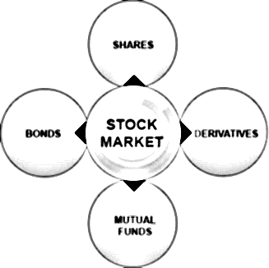
What are Financial Instrument traded?

Slide 49
What are Financial Instrument traded?
Bonds
Definition Bonds are debt instruments used by companies to raise funds from multiple investors in exchange for regular interest payments and repayment of the principal amount at maturity.
Investment Mechanism Investors lend money to the issuer (company) by purchasing bonds, and in return, they receive periodic interest payments and the principal amount at the bond's maturity.
Characteristics Bonds feature face value (the borrowed amount), coupon rate (interest rate), coupon payments (interest payments), and maturity date (deadline for repayment).
Debt Instrument Bonds are considered debt instruments because they represent a loan from investors to the issuer.

Slide 50
What are Financial Instrument traded?
Shares (Stocks)
Ownership Certificate Shares represent ownership in a corporation, with each share entitling the holder to a portion of the company's profits and losses.
Secondary Market Trading Shares are bought and sold in the secondary market, allowing investors to trade ownership stakes in companies.
Risks Share ownership carries risk as the value of shares can fluctuate, impacting the investor's returns.
Potential for Growth As companies perform well, the value of their shares typically increases, offering potential for capital appreciation to shareholders.

Slide 51
What are Financial Instrument traded?
Mutual Funds
Investment Pooling Mutual funds pool money from multiple investors to invest in a diversified portfolio of stocks, bonds, or other financial instruments.
Professional Management Managed by professional fund managers who make investment decisions on behalf of investors.
Unit Holders Investors in mutual funds are known as unit holders and receive returns through capital gains or dividends distributed by the mutual fund scheme.
Diversification Mutual funds offer diversification benefits, spreading investment risk across various assets.

Slide 52
What are Financial Instrument traded?
Derivatives
Risk Management Tool Derivatives are financial instruments used for managing risk associated with price fluctuations of underlying assets such as stocks or commodities.
Agreements for Future Transactions Derivatives allow investors to enter into agreements to buy or sell assets at predetermined prices in the future.
Hedging and Speculation Investors use derivatives for both hedging against price risks and speculating on future price movements.
Complexity and Risk Derivatives can be complex and involve inherent risks, requiring a thorough understanding of the market and underlying assets.

Slide 53
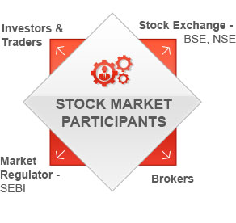
What Does SEBI DO?

Slide 54
What Does SEBI DO?
Regulation of Stock Markets by SEBI
Establishment and Mandate The Securities and Exchange Board of India (SEBI) was established in 1988 by the Government of India to regulate the securities markets. It became an autonomous body under the SEBI Act of 1992.
Responsibilities SEBI is entrusted with the oversight of both the primary and secondary markets in India.
Autonomy and Authority SEBI operates independently and exercises significant authority in regulating and overseeing market activities.

Slide 55
What Does SEBI DO?
Regulatory Measures
SEBI regularly formulates and implements comprehensive regulatory measures to ensure the safety and transparency of securities dealings. These measures are aimed at safeguarding the interests of investors and promoting the development of the stock market.
Objectives
Protecting Investor Interests SEBI works to safeguard the interests of investors in stocks by enforcing regulations that promote fair and transparent market practices.
Promoting Market Development SEBI plays a pivotal role in fostering the growth and development of the stock market by implementing policies that encourage investor confidence and market participation.
Regulating Market Activities SEBI regulates various aspects of the stock market, including securities issuance, trading, and market intermediaries, to maintain market integrity and stability.

Slide 56
What Does SEBI DO?
Compliance and Enforcement SEBI monitors compliance with its regulations and takes enforcement actions against violations to maintain market discipline and integrity.
Continuous Improvement SEBI continually evaluates market dynamics and investor needs to adapt its regulatory framework and ensure the effectiveness of its oversight functions.
Overall, SEBI plays a critical role in maintaining the integrity and stability of the Indian securities markets, thereby fostering investor confidence and facilitating market development.

Slide 57
Break even Analysis
Definition
Break-even analysis is a financial tool used to determine the point at which a company's total revenue equals its total costs, resulting in neither a profit nor a loss.
Break-even Point (BEP)
The break-even point is the level of sales at which a company covers all its costs and earns zero profit.
It signifies the point where total revenue equals total costs, resulting in a net income of zero.

Slide 58
Break even Analysis
Key Aspects of Break-even Analysis
Single Product Focus Break-even analysis is typically applied to a single product to assess its profitability by comparing revenue and costs related to its production and sales.
Profit/Loss Estimation In addition to identifying the break-even point, break-even analysis also helps in estimating the amount of profit or loss at different levels of activity.
Assumptions Several assumptions are made when conducting break-even analysis, including having only one product, classifying costs as fixed or variable, constant costs and selling price, equal production and sales, and no changes in materials, labor, design, or manufacturing methods.
Fixed and Variable Costs Break-even analysis distinguishes between fixed costs (e.g., rent) and variable costs (e.g., raw materials). Fixed costs remain constant regardless of production levels, while variable costs fluctuate with changes in production.

Slide 59
Break even Analysis
Components of Break-even Analysis
Increasing Levels of Activity Analysis involves assessing different levels of production or sales.
Estimated Production Costs Determining the costs associated with producing the product at various activity levels.
Estimated Revenue Calculating the expected revenue generated from sales at different activity levels.
Profit/Loss Calculation Analyzing the resulting profit or loss for each level of activity based on the comparison of revenue and costs.
Conclusion
Break-even analysis provides valuable insights for management accountants by offering a comprehensive understanding of a product's profitability and the level of sales required to achieve breakeven. Despite its simplicity, break-even analysis serves as a fundamental tool for decision-making, aiding businesses in determining pricing strategies, production levels, and overall financial viability.

Slide 60
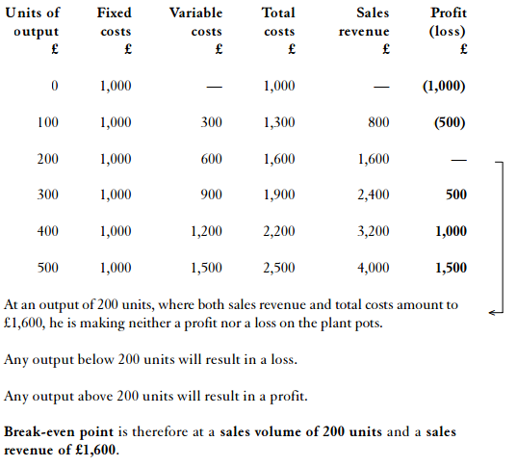
.
Example 1: The following figures have been supplied by A Gardiner, who is considering making plant pots. He is particularly concerned to know how many he must make before the product becomes profitable. Total fixed costs £1,000 ,Variable costs per unit £3 ,Selling price per unit £8
We can draw up a table to show the information.

Slide 61
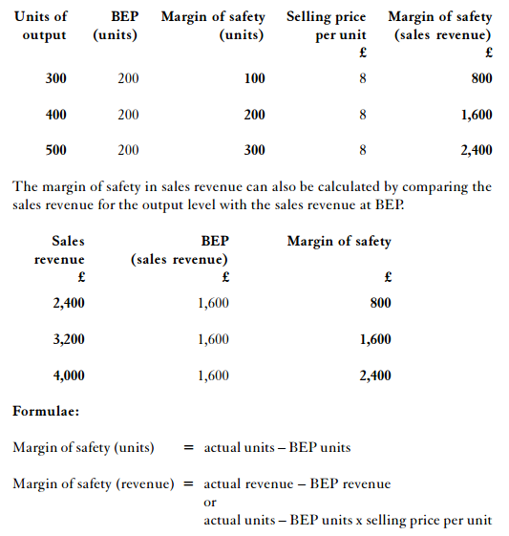
Profit/loss
Profit/loss (the difference between sales revenue and total costs) at various output levels. At 100 units of output the loss is (£500) and at 400 units of output a profit of £1,000 is made. Break-even analysis is thus useful in forecasting profit/loss figures for different production levels.
Margin of safety
Output above BEP which gives a profit is the margin of safety. This margin can be measured by comparing the level of output with BEP and it can be expressed in units or in sales revenue.

Slide 62
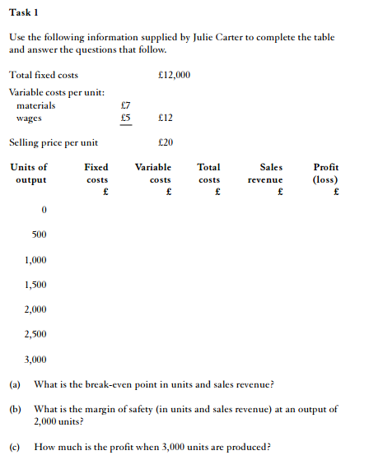

Slide 63
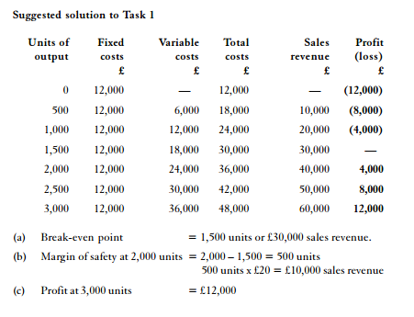

Slide 64
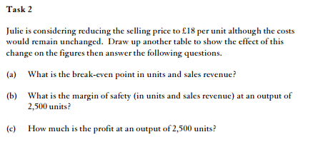

Slide 65
